Slide 1

Deployment of Web Hosting Infrastructure and Centralized Management
NTWK8216 - SECTION 2 – CAPSTONE
Prof. DREW HALLMAN

Slide 2

Group 1 Group Members:
Aagam Shah (8934450)
Pragnesh Chaudhry (8937680)
Rishi Patel (8940502)
Taranjit Chani (8861991)
Urvish Sanghani (8947081)
Yug Patel (8938573)

Slide 3
Project Introduction
NextGen is building a reliable IT setup for its new offices in Los Angeles and Singapore, the plan includes providing the right computers for staff and front-end support, along with high-performance servers to ensure smooth and scalable operations. Both offices will be connected through a well-structured IP network for seamless communication. This setup will support NextGen’s growth by ensuring efficiency, security, and reliable operations.

Slide 4

topics will be covered
Project Introduction
Diagram
OU Structure
Website (NextGen)
Zabbix Monitoring Tool
Zammad Ticketing Tool
Confluence Collaboration Tool
Exchange Server 2019
HeadWind MDM Solution
Security
Advantages & Disadvantages
Area of Improvements
Challenges
Future Planning

Slide 5
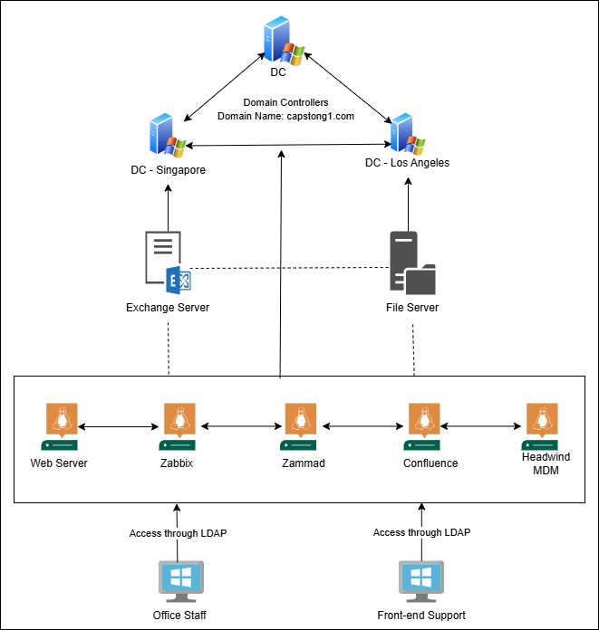
diagram

Slide 6
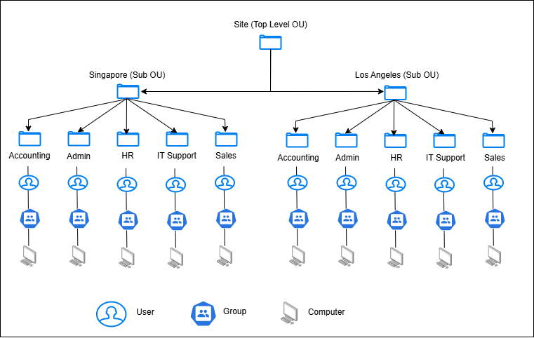
Ou Structure

Slide 7

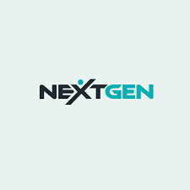
NextGen Website
Linux Environment:
Hosting platform based on a Linux Server that is safe and reliable.
Apache HTTP Server:
Utilized for dependable efficient web hosting.
Docker Integration:
Docker containers simplify deployment for consistency and mobility.
Scalable And Maintainable
For the hosted website, Docker guarantees rapid updates and simplifier scaling.
Optimized Workflow
A reliable, portable, and effective hosting solution is offered by the combination of Apache with Docker.

Slide 8
NextGen Website Cont..
Hosting Environment
Apache is used to host the website on a Linux server in a Docker container, making deployment and upkeep simple.
Homepage:
Clear and uncomplicated homepage layout with clickable buttons for key tools:
Zabbix, Zammad, Confluence, Headwind MDM
Interactive Navigation:
When a tool is clicked, a popup window with:
Basic details about the tool.
A “Visit tool” button that provides instant access to the dashboard of the tool.
Seamless User Experience:
An appealing and simple-to-use interface is achieved by combining intuitive design with visual upgrades (from the photos folder.)

Slide 9
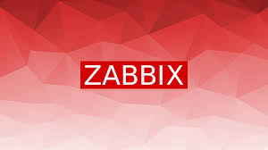
Zabbix Monitoring Tool
What is Zabbix?
Zabbix is an open-source enterprise-level monitoring tool that measures and tracks the performance and availability of IT infrastructure, services, applications, and other resources. It offers a single platform for gathering, evaluating and altering system metrics.
Apache web server
MySQL
Zabbix Version 6.4
LDAP for Role Based Access
SMTP Configuration

Slide 10
Zabbix Monitoring Tool cont..
Why Zabbix?
Key Features of Zabbix,
With Agent and Without Agent Monitoring
Data Analysis: CPU usage, memory consumption, disk usage, network traffic, and application-specific performance.
Distributed and Centralized Monitoring: Monitor geographically distant environments with proxies, ensuring scalability for large scale systems.
Communication Media: Zabbix sends real-time alerts and notifications by email, SMS, or integration with third-party tools like Zammad, rocket chat, office 365, telegram and more.
Customizable Dashboard: Offers flexibility and add specific wizard such as clock, graphs, host and more.

Slide 11
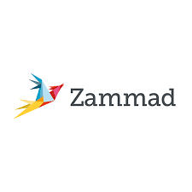
Zammad Ticketing Tool
Deployment With Docker
Zammad is hosted in a Docker container, which guarantees mobility and economical use of resources.
LDAP Integration:
Connected with LDAP to enable smooth user administration and centralized authentication.
Streamlined Ticketing:
For creation, monitoring, and administration of customer support tickets, Zammad offers a single platform:
User-Friendly Interface:
A user-friendly dashboard facilitates simple navigation and prompt support request handling.
Efficient Resource Utilization:
Docker guarantees great performance, scalability, and lightweight deployment

Slide 12

Confluence Collaboration Tool
Centralized Collaboration:
Serves a central location for arranging and exchanging project expertise and documents.
Integration:
Makes use of LDAP for user administration and centralized authentication.
Enhanced Teamwork:
Makes it possible for team members to collaborate in real time and update documents at the same time.
Customizable Spaces:
Designated areas for resources management and documentation unique to a project.
Improved Productivity:
User-friendly UI with tools to increase productivity, such as task tracking, templates, and search.

Slide 13
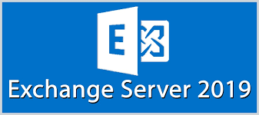
Exchange Server 2019
Microsoft exchange server 2019 is a robust mail and calendaring server developed by Microsoft.
Designed for enterprise-level messaging collaboration, and productivity.
Centralized email management for all users in the organization.
Enhanced collaboration through shared calendars, contacts, and tasks.

Slide 14

HeadWind MDM Tool
Centralized Device Management:
Allows for easy management and observation of the project’s mobile devices.
Integration with Project Tools:
Streamlined site that makes it easier to access programs like Zabbix, Zammad, and others.
Security Deployment:
Enforce device setting and permissions to guarantee adherence to security regulations.
Efficient Deployment via QR Codes:
Simplified device setup with automatic configuration utilizing distinct QR codes.
Flexible Configurations and Support BYOD
Project-specific policies and app deployments guarantee seamless operations.

Slide 15

Security
vSAN (Virtual Storage Area Network): vSAN is essential for disaster Recovery and backup. Which is physically located on Main Domain Controller (Capstone-DC)
GPO (Group Policy Object ): GPO enhance the security and applied on Domain or OU level.
List of applied GPO:
Password complexity (Domain Level)
Default Web Page of Company Website (Domain Level)
Restrict LAN properties access for Users (Accounting, HR, Sales)
Block Instagram for Accounting Computers. (Computer policy)

Slide 16

Advantages
Scalability
High Performance
Sever with specific Configuration
High Range DHCP
High-performance
Smooth connections between both sites and resource Utilization
Allowing Multiple applications to run on single Host
Security
Active Directory (User Authentication)
Group policies
Backup and Recovery by Storage Area Network

Slide 17
Disadvantages
Complex Geographical Troubleshooting Issues
Delay in Data Synchronization
Require strong financial support to manage maintenance and Skilled Workers.
Single Point of failure

Slide 18
Area of improvements
VPN required for site-to-site connectivity, resource sharing, secure communication.
Load Balancing (Proxy Server): Load balancer is an effective solution to balance the load between two sites, it can work as proxy server as well to hide the direct request of main server.
Failover Clustering: Details on regular testing of failover mechanisms and disaster recovery plans would ensure operational reliability.

Slide 19
challenges
We have tried to configure all tools with a single container, but we failed to do so as we have different databases for each tool resulted in database conflict.
We have configured Zammad with two docker containers but fail to synchronize the data.
In Zabbix monitoring tool we have configured the communication media Gmail using SMTP configuration but the Gmail service delay to send the mail.

Slide 20
Future Upgradation
Deployment of all tools using single Docker container.
Synchronize data between two sites via docker.
Configure SQL server to gather real time data from tools.

Slide 21
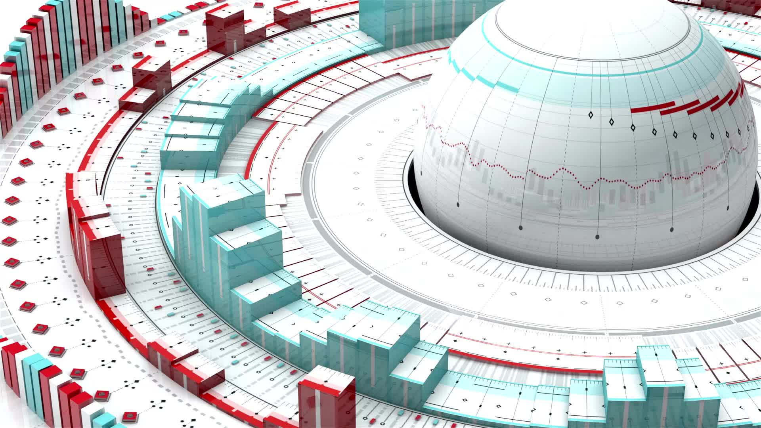
coNclusion
The infrastructure provide by NextGen in Singapore and Los Angles is effective, safe, and scalable. To cut expenses and improve corporation, it makes use of virtualization, open-source technologies, and dependable communication. It guarantees operational success and worldwide competitiveness in spite of early difficulties.

Slide 22
Thank you

